Slide 1





Working smarter: using R to modernise infectious disease surveillance processes
Lynsey Patterson
Head of Health Protection Surveillance
Senior Epidemiological Scientist & Honorary Research Fellow
E: lynsey.patterson@hscni.net
Notes:
Intro about PHA and disease surveillance

Slide 2





Rationale for change
Not
Notes:
PHA Drivers:
Growing work programme which was not manageable
Existing reports time consuming – all done manually
Staff no time for development – doing routine work
Trust Drivers:
Epi reports produced 6 weeks after quarter ended – partly due to availability of data
Reports only to hospital level and this was limited as a static report
Ultimately not fit for purpose in terms of driving improvement so not used

Slide 3





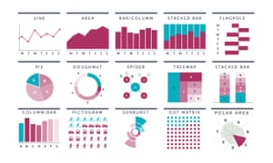

Service context
Notes:
No money
Needed to be secure – PII
Staff competence
Outputs

Slide 4
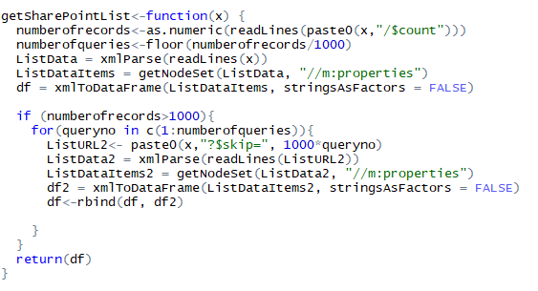
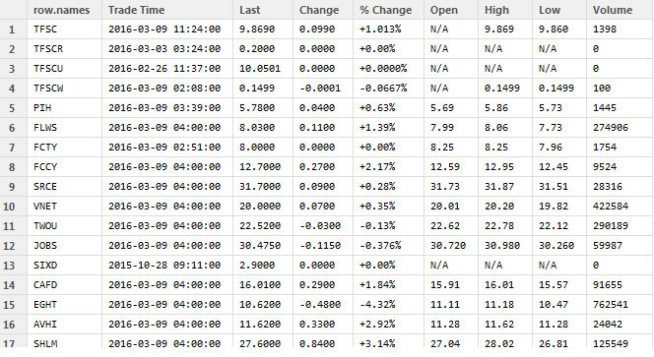
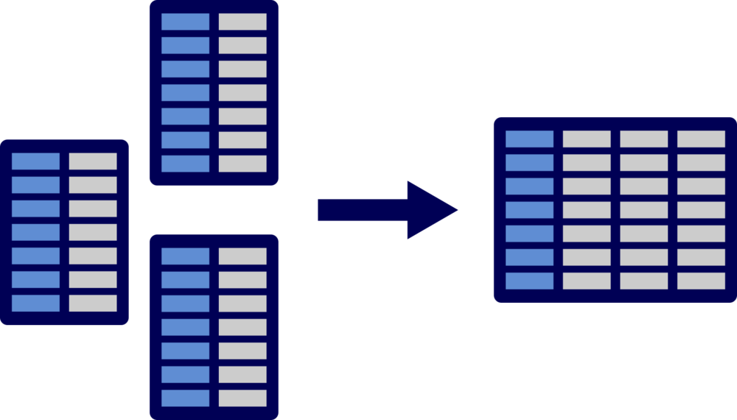
Data extraction

Slide 5


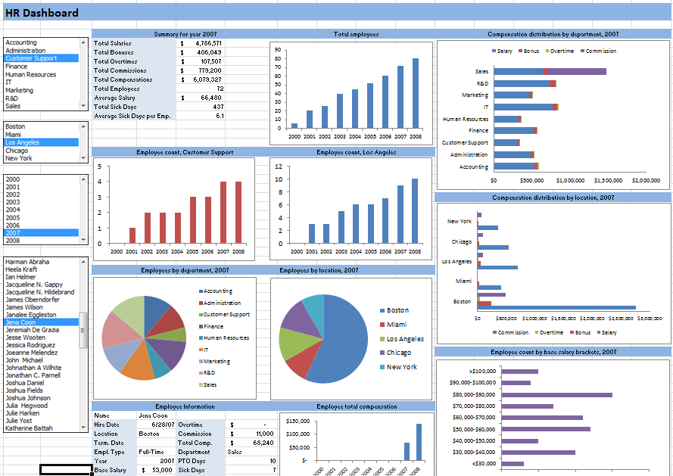
Live dashboard*
*example only – not live PHA dashboard
Notes:
?For the audience – within the security constraints of HSC can we use R dashboards?

Slide 6
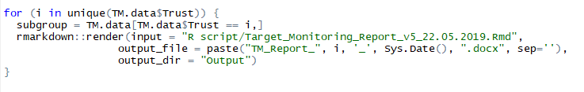
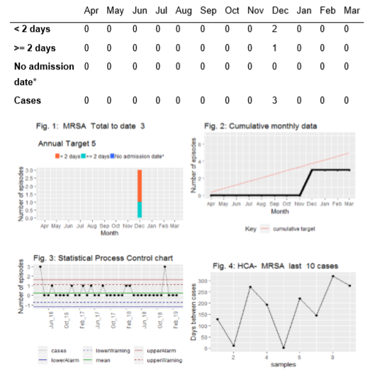
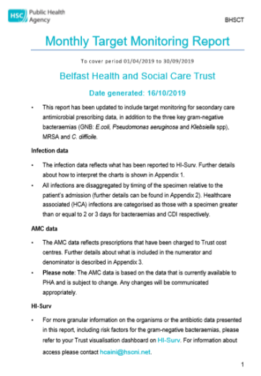
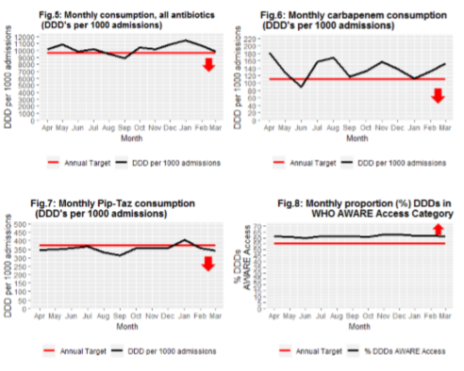
Monthly reporting

Slide 7
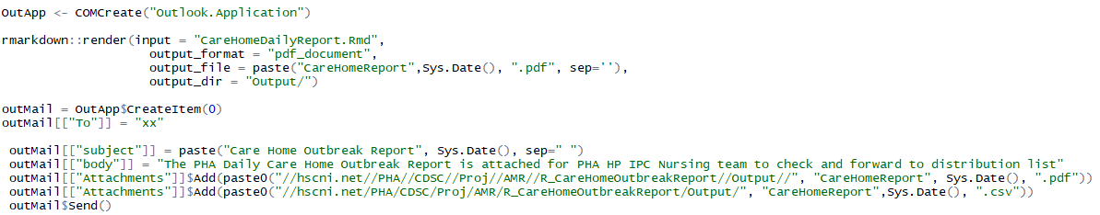
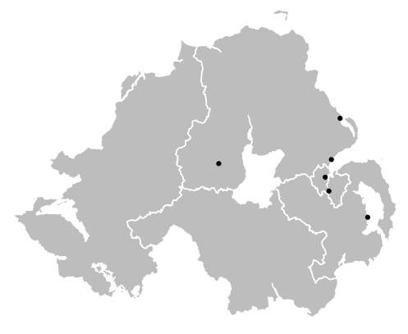
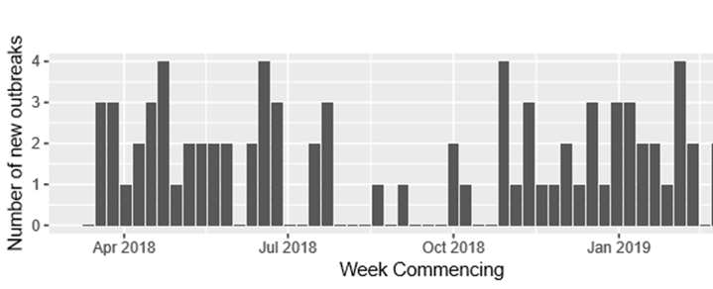
Daily outbreak report
Notes:
Mentioned the direct email

Slide 8

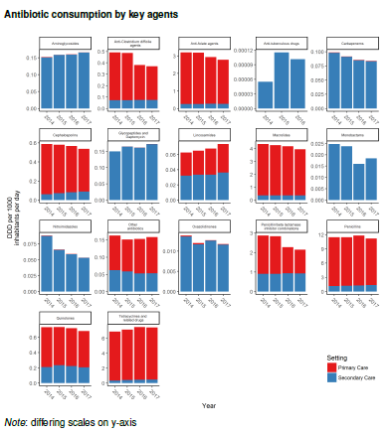
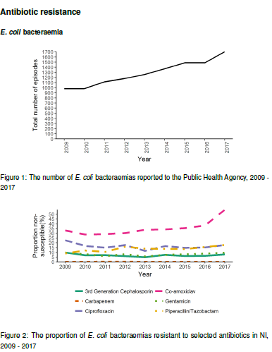
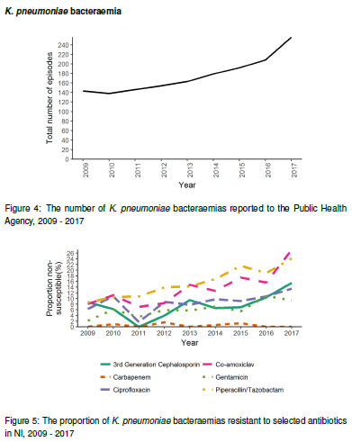
AMR Annual Report
Available here: https://www.publichealth.hscni.net/sites/default/files/2019-02/AMR%20annual%20report%20final%202018.pdf
Notes:
‘lapply’
Embedded script
Facets
Formatting
Hyperlinks

Slide 9


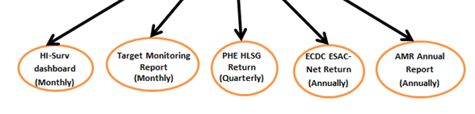
Data wrangling - AMC
Large dataset
Standardise data
Identify unique codes
Merge datasets

Slide 10
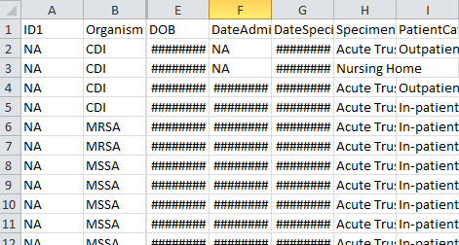
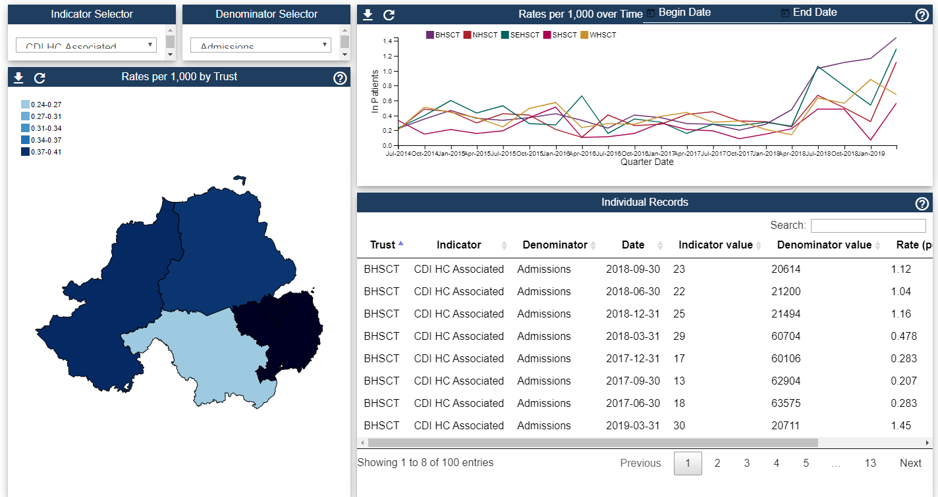

Public Facing Dashboard
Available at: https://www.publichealth.hscni.net/directorates/public-health/health-protection/healthcare-associated-infections-antimicrobial [use Chrome]
Notes:
Took a long dataset – by admission, made it wide

Slide 11
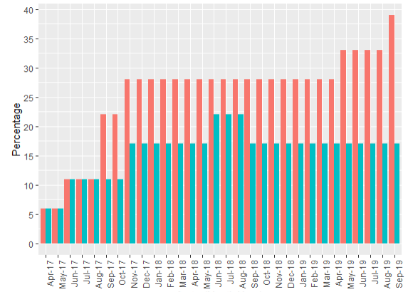

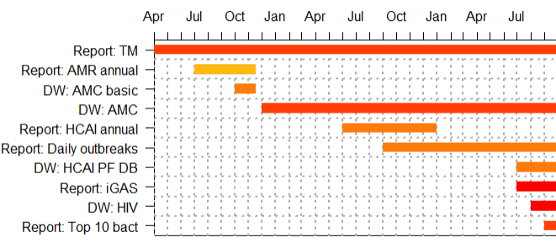
Timeline
Notes:
Slow increase in the number writing code – and we’ve lost the skill
More people comfortable with running code
But still only one third of surveillance staff using the software, despite the gains
Reflected in outputs.. Started out with a report focus – slowly shifting into data wrangling, moving away from traditional software like excel and access
People now using it for ad hoc reports too – mostly because of the size of the data

Slide 12
Benefits
Efficiency
Reproducibility
Accuracy
Standardisation (brand)
Staff morale
Notes:
The benefits for the service…

Slide 13
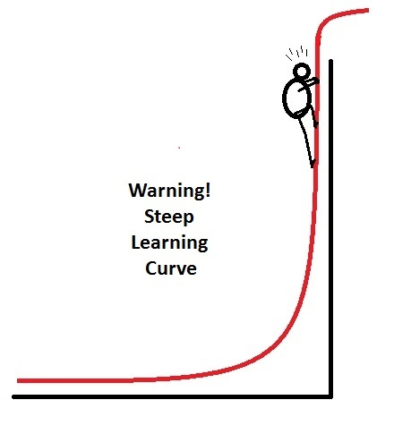

Key challenges
IT Constraints - dashboards
Upskilling staff
Time
Support
“Why you doing this to me?”

Slide 14

Please get in touch!
E: lynsey.patterson@hscni.net

Slide 15

Help slides

Slide 16
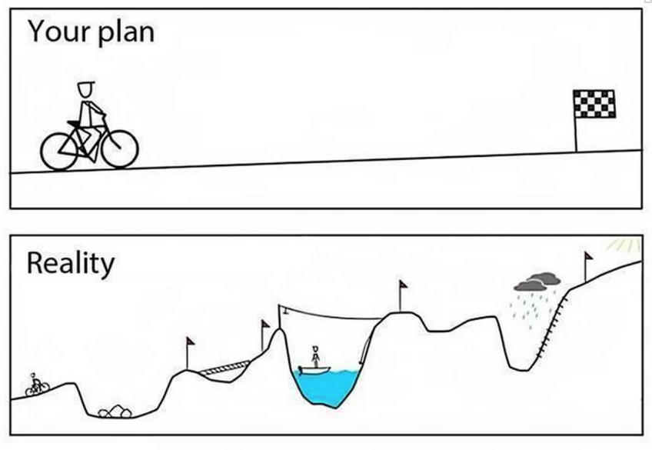
Key learning
Pick a task
Training (internal and external)
Embrace individuality
Trial and error
Many ways to do the same thing
Be patient!
Notes:
Mention that we’re not experts but we’ve managed to use these tools to do a job!

